Slide 1

Walking the walk…..
Creating a Whole School Wellbeing Culture
Doing it because it’s right,
not because Ofsted are looking at it!

Slide 2
Creating a wellbeing culture. What is it and what does it look like?
I have previously created an audit tool for schools in terms of what Ofsted are looking for under their new Education Inspection Framework 2019. That tool is for checking against compliance. However what we should be doing is embedding a culture of wellbeing within our schools which is part of the DNA of the school. It’s how we do things here.
For a whole school culture to be embedded it needs to be:
Clear and well articulated
Shared with and understood by all staff
Dictated by principles and values such as humanity, fairness, kindness, equity, transparency and empathy.
An embedded wellbeing culture doesn’t mean that schools and school leaders don’t make hard decisions affecting staff, but that those decisions and processes have all the qualities outlined above.
Much of what follows is taken from the wealth of information to be found in Andrew Cowley’s excellent book “The Wellbeing Toolkit” and from Dr Rangan Chatterjee’s work around alleviating long term conditions without the need for medicine, combined with my own work as a Headteacher in Blackpool in developing a wellbeing friendly school.
This document will change and adapt as I hope to develop a tool to be used by schools based on my own research across the country with schools who are leading practice in this area.
There have been and will always be those who see wellbeing as the product of a snowflake generation but the times are different. We now have:
The greatest scrutiny on school and staff performance than we’ve ever had – parents, press and social media
Teachers and school leaders habitually working in excess of 20 hours unpaid every week

Slide 3

Why is a wellbeing focused school important?
The incidence of mental health in the general population is at an all time high
roughly 25% have or will suffer from a MH condition each year.
MH illness can be something which is less visible than physical ill health.
Often leading to assumptions being made about staff being mentally healthy.
If the wellbeing needs of staff aren’t met we could be passing stressors and poor
wellbeing on to the pupils we teach.
Sometimes our staff need protecting from themselves. Unreasonably long hours have become the norm.
If we truly care about the wellbeing of staff over which we have duty of care we need to make sure that they are cared for, for themselves and cared for, to be their most effective for the pupils.
Schools act as system changers and role model providers. If we want a far more caring society in the future we need to model this now.
If we want to keep our staff in terms of retention how do we mark ourselves out as employers of choice?

Slide 4
So what is a wellbeing culture?
Being genuinely interested and actively supporting the welfare of the staff and pupils in your school.
Creating a workplace which values the people and not just the outcomes. Allowing people to thrive.
It’s a measure of social progress, and arguably should be the aim of every government.
It’s about quality of life; positive physical and mental health and a sustainable future.
What wellbeing isn’t…
About creating one off events – sustainability?
Creating one off events but then driving staff to work consistently beyond reasonable hours.
Driving processes in school which take little cognisance of wellbeing whilst finishing at 1:30 on the last day of term for wellbeing reasons.
Office for National Statistics Definition:
Wellbeing, put simply, is about ‘how we are doing’ as individuals, communities and as a nation and how sustainable this is for the future.

Slide 5


Wellbeing: a lens to view what we do and how we do it...
We need to see things differently.
As well as what can we do to support staff wellbeing, how can we do things to support wellbeing?
A staff wellbeing team is a good idea – provides ownership of wellbeing but is often about doing things. Free tea and coffee and recognition of staff birthdays are good things to do but need to be part of an overall approach to wellbeing that is culturally ingrained in what the school does and is about.
Culturally embedded wellbeing needs to be a strategic objective.

Slide 6
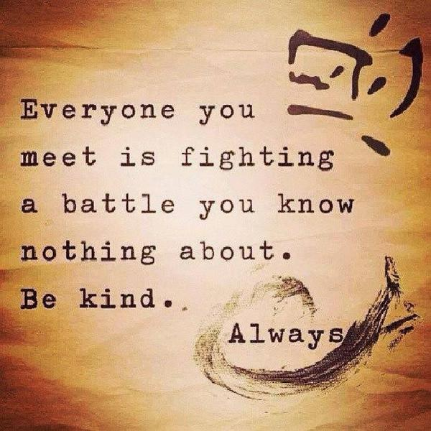
My biggest learning as a headteacher….
Even if you have the very best professional relationship with your staff you will not know what is going on in the lives of your staff from day to day.
How empathetic are you?

Slide 7
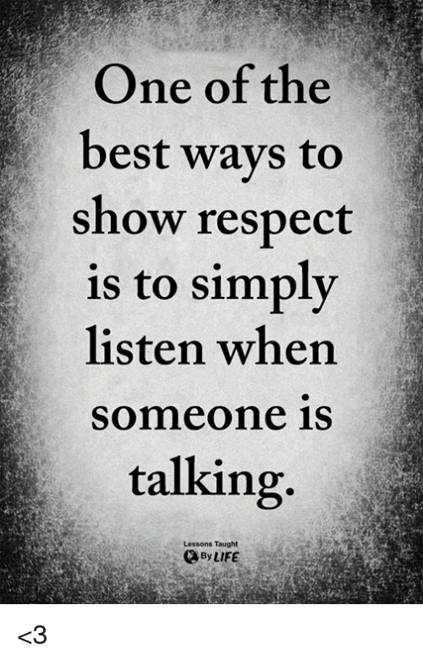
Two ears and one tongue!
The art of listening and value.
The leader who listens and acts is in effect a mentor or coach who facilitates the change that might be required for the individual concerned.
The change may be something minor, dropping into class once or twice a day or giving a reassuring word about an aspect of work causing anxiety, or may involve a shift in organisation to address a more pressing concern.
Such actions demonstrate the visible empathy that demonstrates how each member of the team is valued. Value is critical to wellbeing.
Avoid being:
The leader who can’t listen.
The leader who won’t listen.
The leader who can only listen, but not act.
The leader who doesn’t listen but ‘talks at’ the recipient rather than talking matters through.
Education Support Partnership - 2019

Slide 8
Ethos is central to wellbeing…
The how and why we do things around here.
Relationships are critical – how we treat each other is central to wellbeing both of staff and pupils.
E.g. Do we buy wellbeing support for all our staff? Two tier system? Teacher v TA? Respect difference.
Work hard and play hard – we work hard to achieve our goals but in doing so we put people first. Duty of care?
How do we support our staff? WB days/ sensitive leave, RTW interviews, referral to OH. Do we provide opportunity to celebrate achievements?
Team Building; Us before I – we use the language of us and our rather than me and I. Far more inclusive and welcoming.
Watch for the language as it betrays how we see things! Working to achieve school goals is far more rewarding. Sharing expertise and resource – sharing helps with workload and builds teams.
Sensible risk taking is welcomed – The organisation and leaders allow staff to grow and develop by making mistakes and learning. Having control over your life is key to wellbeing.
Focus; work on what makes a difference – Strip out work which doesn’t have impact. Soul destroying and damages wellbeing.
Embed wellbeing into your ethos.

Slide 9

Wellbeing: Relationships and saying thank you!
How do you say thank you to the staff who regularly go the extra mile?
Is it authentic or tokenistic?
Some find it easy to do others more difficult.
Study those for whom saying thank you seems automatic.
How do governors express their thanks to the head and staff?
Encourage little and often rather than a one off show of appreciation.
RAK – Random Acts of Kindness
Some schools adopt this and have posters welcoming RAK’s.
Other schools adopt a secret Santa approach to kindness, with small gifts left behind.
Sometimes just a post it note being left behind on someone’s desk. Set up a Slack channel!
The staff room! Is a place where wellbeing is fostered? How does your staff room compare?
Challenging acts of unkindness
In some schools saying something unpopular can lead to staff being ostracised. How do we challenge this?
We’re all unique with our own views and all should be respected.
Do you have a code of conduct/ ethics in terms of how we treat each other?
This is just as important as saying thank you.

Slide 10
Wellbeing? What would you do here?
Scenario:
I visited a school where a young teacher and his partner had just got married and wanted to travel the world before they thought about children. They came with a request to the headteacher that they take a year out of school that covered one academic year.
How would you respond to this request?
What are your reasons for making the decision that you did?

Slide 11
Relationships and respect – wellbeing audit
Aspect of school life | What we do now to foster positive wellbeing | Even better if…
Saying thank you and showing appreciation
The staff room “atmosphere”
Challenging unkindness
How do governors support the head and school?

Slide 12
Work hard, play hard… supporting wellbeing whilst achieving goals
Goals and outcomes are how schools are defined but we have a duty of care to support our staff.
How do we manage staff absence? Not being in touch = not caring, being in touch too much = putting pressure on.
Develop SLT where: SBL is pastoral/ health lead, Head/ Deputy focus on goals – balance to be found.
- How do we support staff health and wellbeing?
RTW interviews: about planning for a safe re-integration to school and whether school can provide additional support/ referral to OH for further advice. Regular check ins aid the sense of being valued.
Understanding and appreciation of the individual and their life outside school including health!
Do we help staff to have a life outside of school?
Careful and caring management of absence helps to develop relationship where staff will often share issues outside school affecting their ability to perform in school. Also helps with sensitivity to special leave requests.
NAHT members entitled to paid WB day for staff protected under “Wellness and Protect.”
Annual health checks also provided by Schools Advisory Service.
Some operations provided privately under the policy too.
Staff are busy so why not provide an adult salad bar in the staff room so that staff don’t need to make a lunch and remember to bring it. One less thing to worry about.

Slide 13
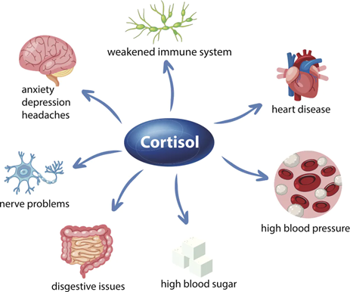
Managing the stress
Working hard and being stressed from time to time are not necessarily bad things.
Working hard without a break and being constantly stressed are!
Prolonged cortisol theft affects other hormone production and affects our health.
Being in the Ofsted window is bad for your health.
So how do you manage the stress of being in the window?
How does your school culture support staff with stress?
We’re in this together – “us against the world!”
Celebrate what you have achieved and are good at.
Be aware of staff who might be more vulnerable and offer support or a listening ear.
Be planned and prepared. Confidence grows and stress decreases with being in control.
Develop team strength – dinner and a few drinks out followed by empowering CPD.
As a senior leader, don’t assume a 4pm departure is a member of staff being lazy. Encourage early leaves.
What can we do to help ourselves individually with stress?
Create “Me” time – min 15 minutes twice a day
Listen to music, bath, gardening, reading.
Have a day screen free!
Ensure at least one day per w/e is school free.
Be still for at least 5 minutes daily.
Create a journal and write something each day that you are grateful for.
3-4-5 breathing – slowing breathing calms the brain

Slide 14
How do you manage stress and help staff to do the same?
You
Staff

Slide 15

Wellbeing: Building teams
Recognition that the vast majority of people prefer to be part of a collective
effort and that we achieve more together as a team.
Recognition that there are multiple ways of achieving our outcomes/ goals.
Aim that we achieve our goals with recognition that:
We do it together/ all have things to bring to the table
With a smile on our faces
We take every opportunity not to lose anyone on the way
But that our goals are ultimately where we need to be for the sake of our children.
Embed ownership of wellbeing within the team that are seeking to achieve our goals and outcomes:
Develop a wellbeing group where membership is open to change
Ensure all teams within the school structure are represented; site, middle leaders, after school, lunchtime staff, senior staff etc. Wellbeing needs will differ from team to team.
You can have goal achievement and wellbeing. They aren’t opposites.

Slide 16

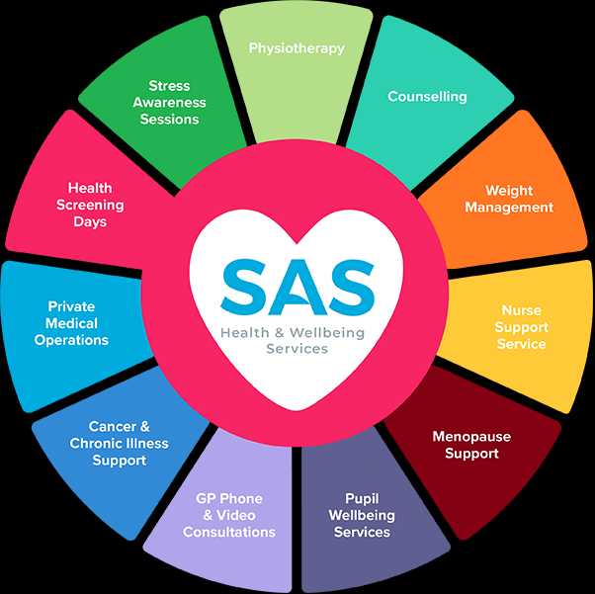

Just three things….
What 3 things am I going to do to build wellbeing into staff teams?
Buy into Schools Advisory Service to ensure that all teams have access to the Wellbeing package that SAS offer!
2)
3)

Slide 17
Risk taking – supporting innovation and wellbeing…
Having control is empowering.
Contributing to the greater goal engenders belonging and ownership.
Both of these things are valuable to overall wellbeing.
As school leaders we don’t have all the answers.
How can you as a school leader support teacher innovation and risk taking?
Wider reading opportunities
Opportunity to become involved in research
Evidence based practice CPD
The dangers of not doing so!
Health and Safety project with Goss +ve
Inherited staff team -ve
How might the same empowerment with learners change outcomes and improve their wellbeing?

Slide 18
Impact and workload – stripping out the soul destroying!
“As a teacher I worked in one school where for every learning objective, every child had one of three boxes I had to tick to decide whether they had learnt, not quite or not got the concept. A decision had to be made over 525 boxes each day and no one ever looked at it. What is the point, its soul destroying?”
Time is the most valuable commodity in school and needs to be used wisely.
Staff personal time even more so. So what are we doing to give them time back?
As a senior leader try to avoid putting time heavy events together – spread out parents evenings, productions, report writing and termly data drops so they don’t coincide.
Where possible, where goodwill time has been spent by staff try to give it back when possible. Cancel un-necessary staff meetings. Don’t have one simply because Wednesday night is staff meeting night.
I planned two weeks holiday in June because:
It gave parents and staff chance to take a family holiday at the cheapest time of the year
It gave staff a week to write reports and a week for a complete break.
Be as accommodating as possible in giving discretionary leave to repay the goodwill time given by staff.
Model leaving early. Some staff stay late so that they “don’t look bad in the eyes of the head.”

Slide 19
So what changes can you make to strip out workload and create a better life for your staff?
Things that we can change….
How might we change them?

Slide 20
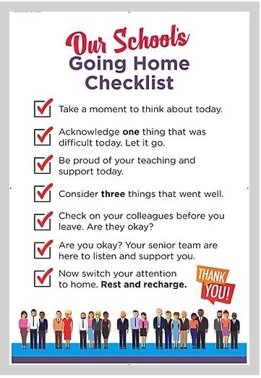
Making decisions about wellbeing…Cost v value
If we bought £800,000 worth of tech for our schools it would be reasonable to assume that we would probably spend at least £20,000 on warranties to ensure the new kit was properly maintained and didn’t fall over.
However do we apply the same logic to our most valuable resource in school, the staff?
When making decisions about staff do we view the cost before the value?
Can we afford to do this given the cost of staff not being in school, being unwell or feeling undervalued?
What does the school’s investment in the staff and the seamless running of a high quality educational provision say about its intention or the value placed on staff wellbeing.
“At SAS we believe that prevention is better than cure.”
Poster courtesy of Kelsall Primary School and Dave Wearing

Slide 21
Investing in staff…
A key part of showing staff that you value them is by investing in them and their professional development and wellbeing.
A key moment in my school was when we were fighting back from RI and I took the teaching staff away to introduce a new style of teaching.
Benefits: Teaching staff ate, drank and bonded and developed a sense of unity and common purpose.
Mistake: I should have taken all class based staff and maybe done something with the rest of the staff.
How do you show the staff that you value them and invest in them?

Slide 22
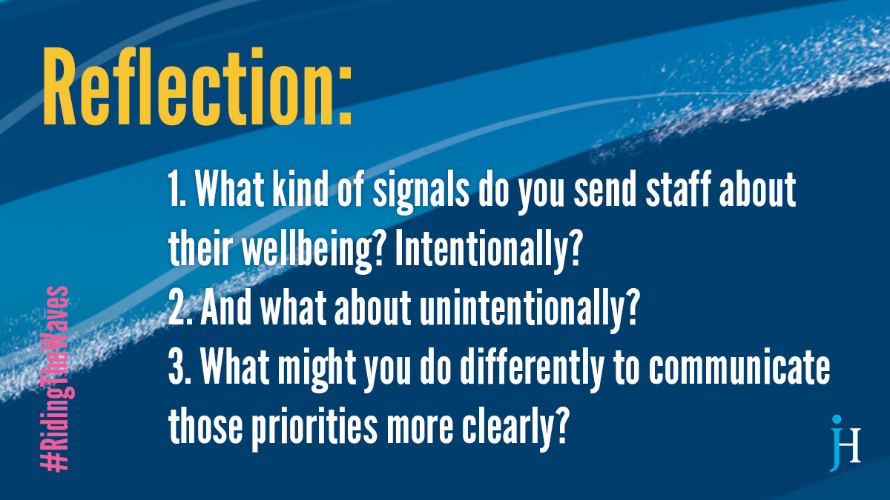

Slide 23
Conclusion and summary…
Wellbeing and doing what is right by the staff to support their wellbeing and develop goodwill has to be more than paying for tea and coffee and biscuits on a Friday.
It has to be school wide, system wide, a way of thinking that shows empathy and respect for the circumstances that staff find themselves in.
If we ignore wellbeing and treat staff as paid machines to deliver without due regard for their wellbeing we put a time limit on the sustainability of what we as school leaders want to do with the school and the progress we want to make.
Critically as school leaders we also need to see ourselves as fallible and be prepared to fit our wellbeing oxygen mask before we attempt to support others with theirs.
What conversations are you having with your chair about your wellbeing? They have a duty of care over you as you have over your staff.

Slide 24
Covid 19 – Wellbeing implications for staff and pupils
Implications for staff from impact of Covid and lockdown on personal lives, illness worry and bereavement.
Huge anxieties created from conflicting government and scientific advice.
Concern over family members shielding, impact of children as asymptomatic carriers.
Concern over management of all children in “bubbles” and seeing all children. Fitting all in with 2m distancing.
Concern over all children back by end of summer term!
Concern over September.
Key points of advice:
Legislation trumps guidance … only admit increased numbers if you can meet obligations to health and safety of all (Health and Safety at Work Act 1974)
Step by step process. Forget September for now. Support staff in front of you and deal with what is immediate. Plan, support staff with empathy and take baby steps in getting children back.

Slide 25
Contact details: andy.mellor@uk-sas.co.uk
@andymellor64
07593818691

