Slide 1


Conference Sponsors:
Summer Term Conference
14th June 2023
Eastwood Hall
Frances Rowland – Chair of ABLE
Our Partners:

Slide 2

Housekeeping
No longer mandatory to wear masks but please be considerate of those who are
No fire action planned – please make yourselves familiar with fire exits
Toilets are in the corridor near the entrance
Please turn mobile phones to silent
Lunch will be served in the restaurant, buffet style
Both refreshment stations are open today
There is a smoking area to the side of the bar area

Slide 3
Today’s Agenda
9:15-9:45 Partner Updates – SAAF, Education Mutual, Breedon, Zenergi and Atom IT
9:45-10:00 Sponsor – Canopies UK
10:00-10:45 Keynote – Will Hussey, The Science of Flourishing
10:45-11:30 Coffee, Exhibition and Networking
11:30-12:30 Choice of Workshops
12:30-1:30 Lunch, exhibition and networking
1:30-2:30 Choice of Workshops
2:30–2:50 Tea, app questions, complete evaluation, raffle results
2:50-3:30ish Panel on Recruitment and Retention of Staff

Slide 4
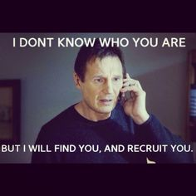
Today’s panel – Recruitment and Retention of Staff
Please write any questions you
have for the panel on the paper on your table
Drop paper onto my table up
front before lunch time

Slide 5

Raffle tickets
You can collect raffle prizes in the afternoon break.
At the last conference there was an unclaimed bottle of gin!

Slide 6
Today’s Charity – Spectrum WASP
Support for children and YP on Autistic Spectrum with Disabilities, Special and Additional Needs.
Please join with us to support this worthy cause by purchasing a raffle ticket from Jo or Clare at the Raffle stand, we have a lovely selection of prizes donated by our sponsors.
Online donations can be purchased via ‘local giving’ please show Jo or Clare your donation to obtain your raffle ticket. There is a link to this page in the app. Or cash at the raffle stand.

Slide 7
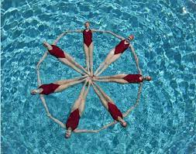
Free access to Eastwood Hall Leisure Facilities
For those of you who booked your free leisure pass with me please sign in at the Leisure Club.
Sadie Fletcher Marj Masters Judy Noble Natalie Collins Louise Dove Esther Horsley

Slide 8
ABLE Membership 23-24
Important Reminder of membership T&C’s
All memberships will automatically renew on the 1st September for another year unless cancelled before 01 July by emailing memberships@able-pro.co.uk
You’re entitled to 3 conferences per year as well as regular business network training events, free mini ISBL membership and access to the ABLE Rewards App.

Slide 9
ABLE Membership 23-24
Membership fees will be £80 p.a. for non-members
Current members will receive a £5 discount, reducing the annual fee to £75

Slide 10

ABLE Membership 23-24
A few juicy incentives
All members will receive 50 reward points to spend next year
Refer a friend and receive 50 reward points. Email Emma (memberships@able-pro.co.uk ) the name of your referral and she will administer the points
Get the rest of your MAT to sign up and receive 10% discount for all schools in the MAT

Slide 11
New initiative for 23-24
Member forum- get direct support from peers and corporate partners on hot topics
Due to be launched in the Autumn Term

Slide 12
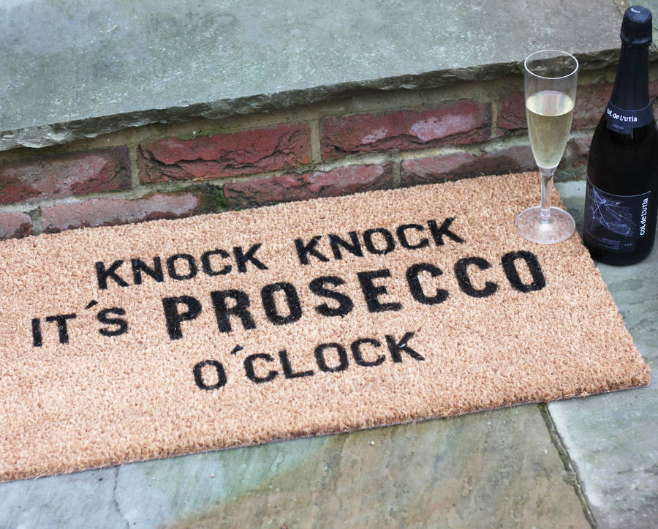
Reward gifts go to:
Alex Epton, 2 x chocs and Amazon voucher
Anne Hall, 2 x bubbly
Sadie Fletcher, bubbly
Liz Wilson, chocs and bubbly
Suki Kaur, Amazon voucher
Dean Grimshaw, bubbly and pamper gift set
Judy Noble, Argos voucher
Lynn Eadie, Asda voucher

Slide 13
Our exhibitors have points today!
All exhibitors have 250 points to share with delegates that engage with them and want to find out more about their services.
That’s over 7,000 points up for grabs today.
Work those points!

Slide 14


Slide 15
ICT Roundtable
At our autumn conference we will be doing an ICT roundtable discussion as one of the workshop choices.
This is a great way for you to speak to Atom IT whether you are a customer or not about current issues.
This may be cyber security, an Excel masterclass or getting the most out of MS 365. You tell us! When you complete the evaluation please let us know what theme you would value most from this session.

Slide 16
Evaluation
Complete the conference evaluation at the end of the day
(link on the app) and you will receive 10 points
We think we are up to date but if you think we owe you points email Emma Cripwell memberships@able-pro.co.uk

Slide 17
Special thanks to our business partners:

